Slide 1

Project Proposal
Bet on Better Forecasts:
Leveraging Customer-Level Insights for Enhanced Financial Prediction for RWWA

Slide 2
About Us
01
Reiko Takizuka (edX: r-takizuka)
Reiko used to work as a researcher in a telecommunications company in Japan for over 25 years. She holds a bachelor’s degree in engineering.
Duc Nguyen Hong (edX: nhduc1993)
Duc holds a bachelor's degree in Finance & Banking and has established himself as a senior data analyst at an outsourcing company based in Vietnam.
Chandana Mudunuri (edX: ana_1009)
Chandana is a Customer Intelligence Analyst working for Racing and Wagering, WA in Australia. She has a bachelor’s in electrical engineering and has accumulated more than ten years of experience in the data field, working in various roles such as data engineer, reporting engineer, and data analyst.
Dayoon Sug (edX: DayoonSug)
Dayoon is IT Service Delivery Manager in Group Functions scope within South Korea at Merck Group. She has a bachelor’s degree in business administration from Georgia Tech.
Michael Sullivan (edX: mikeys1)
Mike is a Trade and Investment Analyst working for UK government. He is an economics graduate, has taken a Data Science bootcamp and will begin the OMSA this year.

Slide 3
Agenda
02
OBJECTIVE/PROBLEM
DATASET/PLAN FOR DATA
APPROACH/METHODOLOGY

Slide 4

I. Objective/Problem
03
Racing and Wagering Western Australia (RWWA) is the controlling authority for horse and greyhound in the state of WA.
Part of the RWWA’s remit is to control off-course betting activities for the racing industry, which they do through the Totalisator Agency Board (TAB), a state-owned company that runs over 300 betting retail outlets and an online betting platform known as TABtouch.
AUS $2.0 Bn
Placed bets
AUS $1.7 Bn
Winning bets

Slide 5



I. Objective/Problem
04
Problems
Research Question
Business Justification
They believe leveraging customer-level transaction data could offer more valuable insights than the time series model.
Can the use of customer-level wagering transaction data improve the accuracy and reliability of financial forecasts vs. aggregate time series methods?
helps the company decide how to spend money on staff, marketing, customer retention, technology improvements and many other areas.

Slide 6
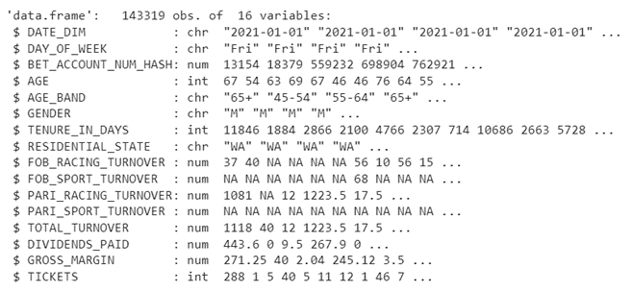
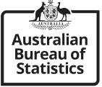
II. Data Sources
05
Primary dataset – TAB Betting data : Each row of this dataset represents the bets made by one customer on a given day.
Key variables:
The dependent variables: GROSS_MARGIN, TOTAL_TURNOVER
The independent variables: AGE, GENDER, RESIDENTAL_STATE, RACING_, SPORT_, FOB_, PARI_, TICKETS
Supplemental Data – Label Force Data :
Official Australian economic statistics on labor force participation and earnings.

Slide 7


III. Planned Approach
06
EDA
Data Cleaning & Preprocessing
Suggested Maintenance
Data Modelling

Slide 8
Business Decision
07
Business decisions | Impact / Benefits
Developing an enhanced financial forecasting model | TABtouch can gain a more accurate assessment of their budget allocation for marketing, technology upgrades, and customer retention initiatives.
 | TABtouch can plan their marketing and customer retention activities more effectively.
Making strategic investments driven by a comprehensive financial forecasting model | TABtouch can increase revenue growth and improve customer loyalty.

Slide 9
Sources
08
Racing and Wagering Western Australia (RWWA):
https://www.rwwa.com.au/
TABtouch:
https://www.tabtouch.mobi/
Customer lifetime value:
https://en.wikipedia.org/wiki/Customer_lifetime_value#:~:text=CLV%2Dbased%20segmentation%20model%20allows,than%20on%20less%20profitable%20customers.
Smart CRM Basics: Customer Behavior Modeling:
https://www.optimove.com/blog/smart-crm-basics-customer-behavior-modeling
Predictive models are helping operators and players to mitigate problem gambling:
https://g-mnews.com/en/predictive-models-are-helping
Official Australian economic statistics on labor force participation and earnings:
https://www.abs.gov.au/statistics/labour

Slide 10
Thank you!

